Slide 1
How to Protect Against Phishing
Stop! Think! Don’t Click that Link!

Slide 2
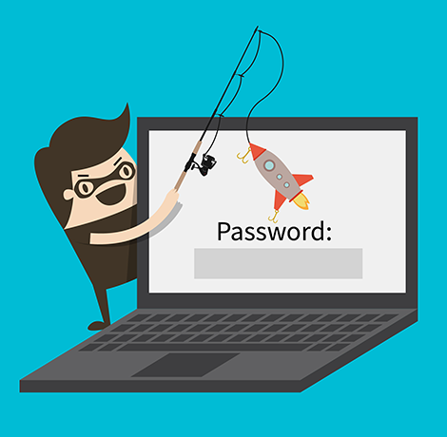
What is phishing?
Cybercrime
Targets are contacted by email, telephone, text, etc.
Someone is posing as a legitimate company in the act of attempting to obtain sensitive information
Ex. passwords, credit card numbers, SSN’s, birthdays, computer types, names, etc.
Notes:
act of attempting to obtain sensitive information, such as passwords, credit card numbers, SSN’s, birthdays, computer types, names, etc.

Slide 3
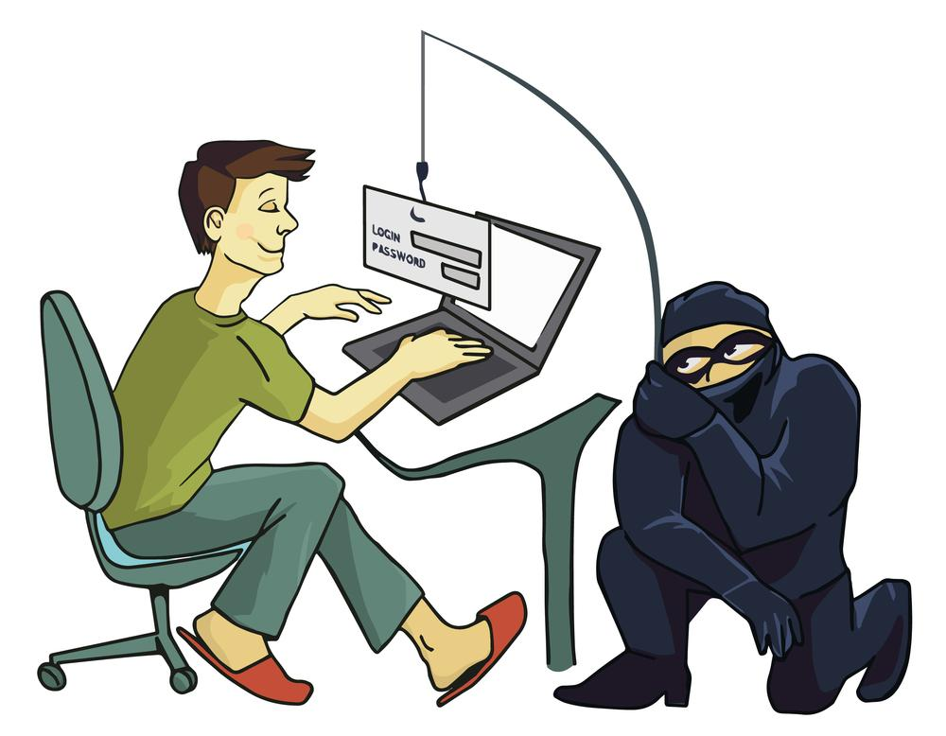
Types of Phishing:
Spear Phishing is the targeted variety of phishing.
Smishing is the SMS variety,
Vishing is the voice/call variety.
If there is a communication method, then there is an -ishing for it.

Slide 4
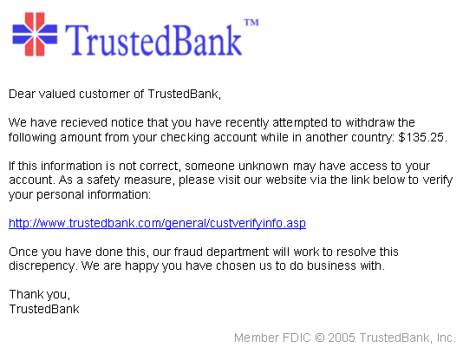
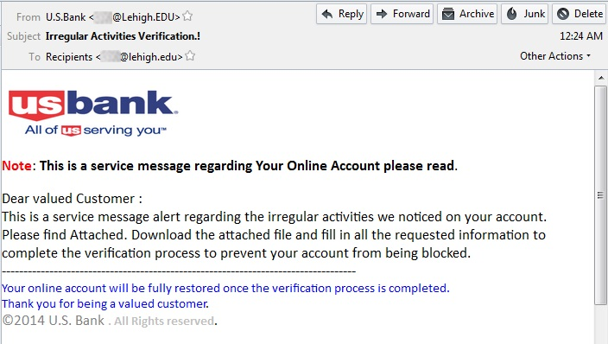
Email Phishing Example:
Notes:
Banks usually address you by your name
Hover over

Slide 5
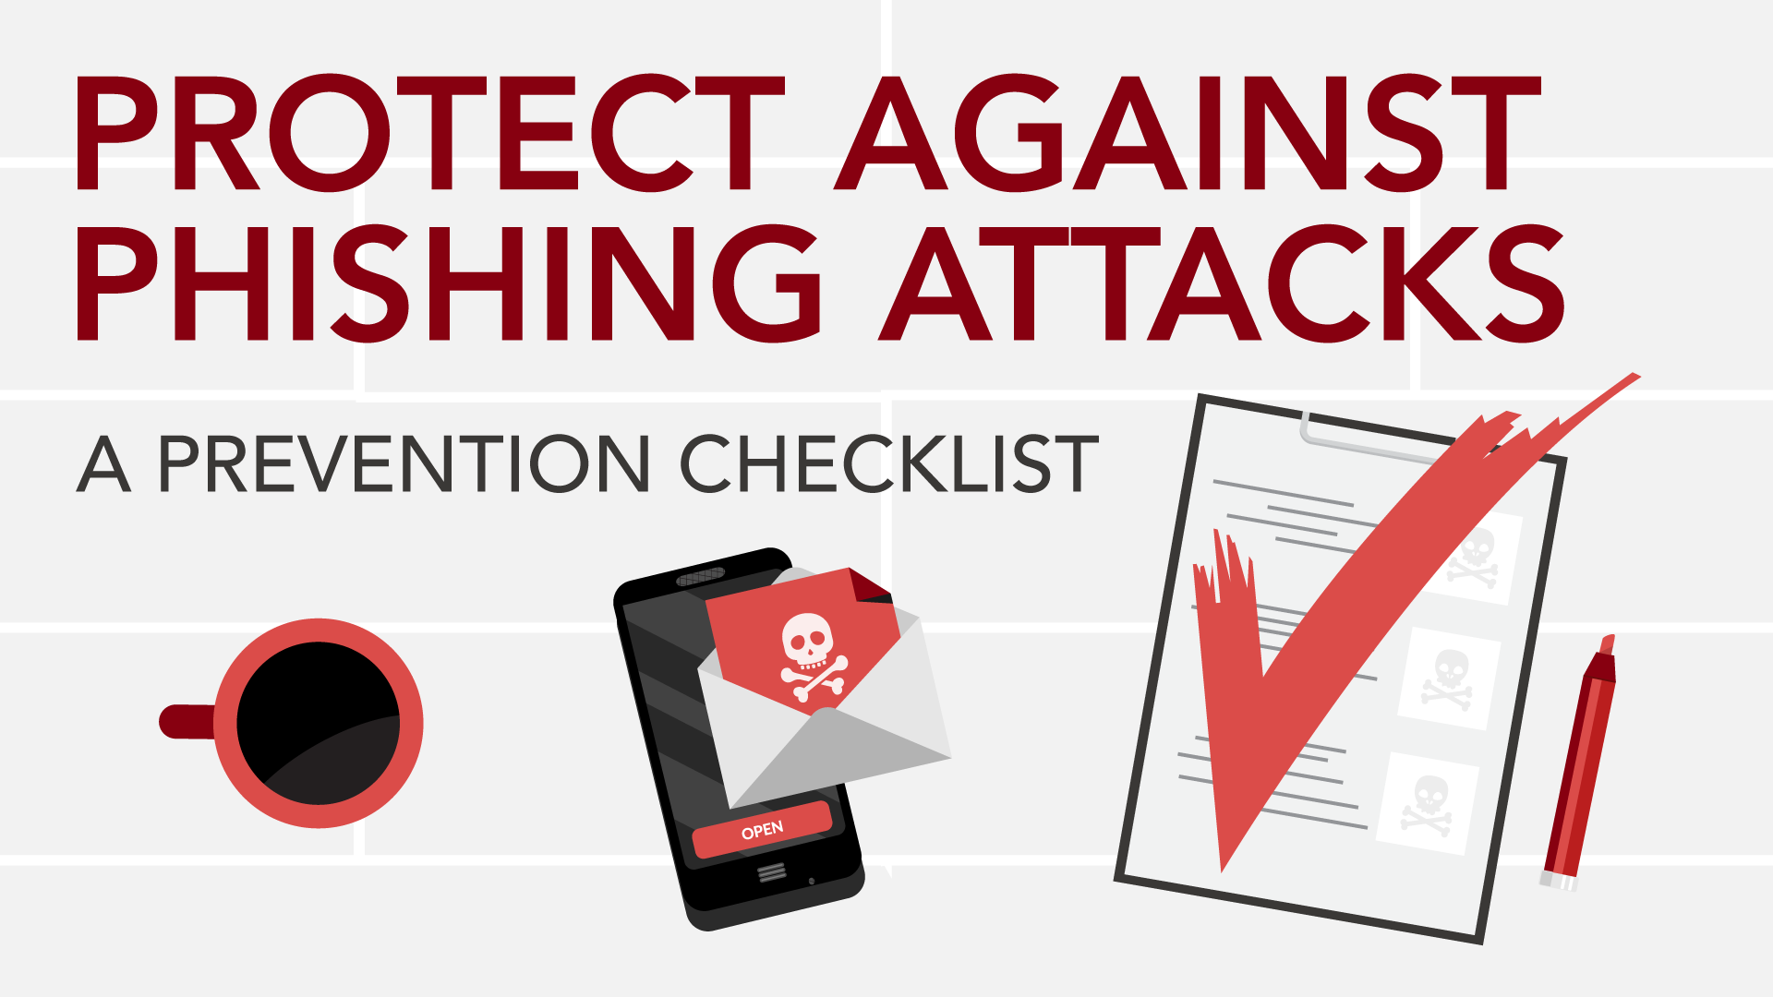
How to Protect Yourself:
Hover your mouse over links to reveal the true source
Carefully review the sender’s email address for spelling errors and suspicious domains
Proper senders will usually address you by your name
If the greeting is vague, be weary of the content and email
Question authority when asked for sensitive data

